Slide 1
Wilsons Promontory
South Gippsland
Victoria
Core units: Exemplars – Year 8
Illustration 1: Landscape and landforms of Wilsons Promontory

Slide 2
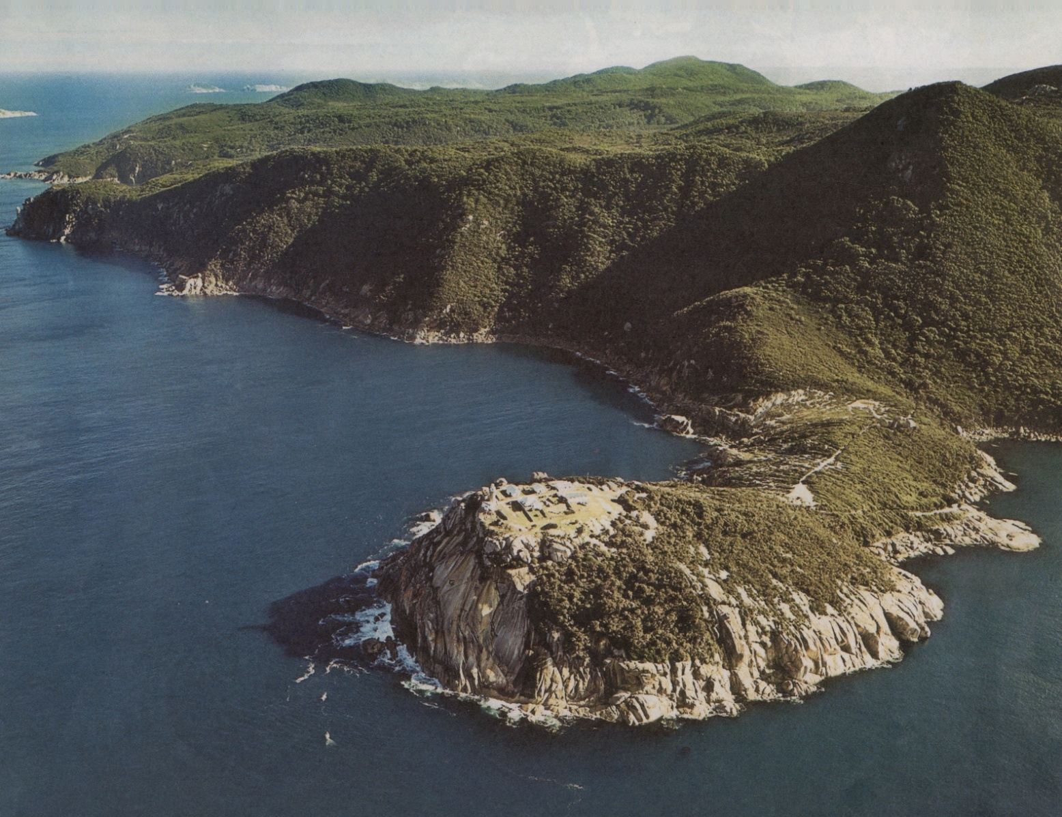
Wilsons Promontory Lighthouse

Slide 3
History
European settlers followed the explorers into the South Gippsland region in the 1870s
The Promontory was named after a London friend of Matthew Flinders and originates from the voyage of George Bass and Matthew Flinders along the Promontory coast in 1798
The first 'reservation' of Wilsons Promontory was proclaimed by the Victorian Government in 1898
Today, Victorians call it 'The Prom'

Slide 4
Wilsons Promontory National Park
The park is located at the southernmost point of the Australian mainland and is more than 50,000 hectares in area

Slide 5
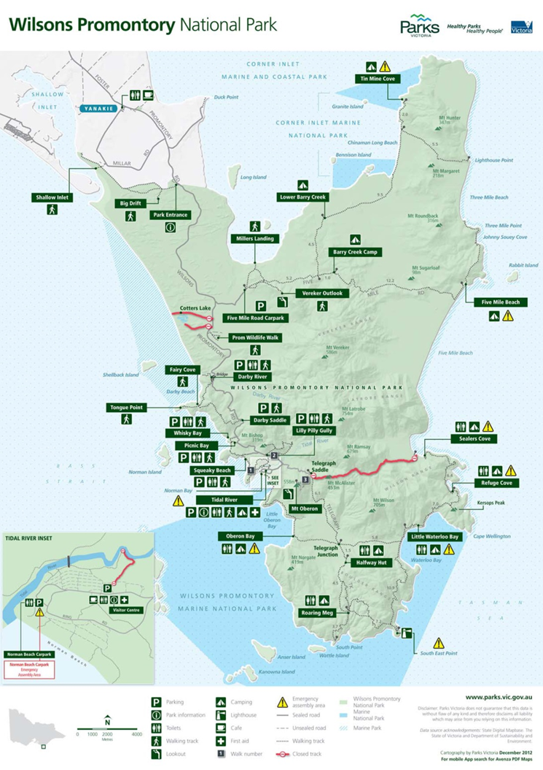
Wilsons Promontory National Park
Source of map: Parks Victoria

Slide 6
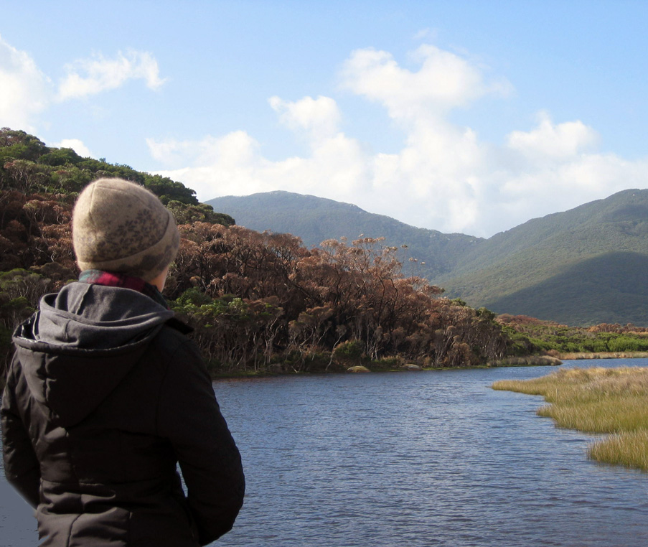
Wilsons Promontory National Park
It has 130 km of coastline and features granite headlands, mountains, forests and fern gullies
Tidal River, 30 km inside the park boundary, is the focus for tourism and recreation and has more than 400,000 visitors a year
The park contains the largest coastal wilderness area in Victoria

Slide 7
Geomorphology of 'The Prom'
The rock that makes up the landforms of the Promontory developed deep below the surface of the earth some 400 million years ago
Molten material cooled slowly and crystallised to form granite.
In time, the softer surface layers eroded leaving the mountains of granite you see today
During past ice ages, the oceans subsided and a range of granite mountains stretched across low-lying plains between the present day states of Victoria and Tasmania

Slide 8
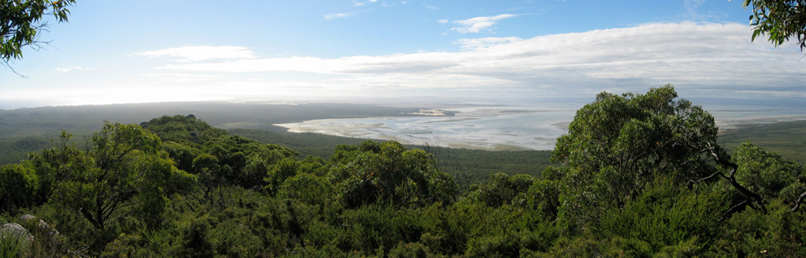
Wilsons Promontory National Park
This photograph was taken in the northern section of the park (the largest wilderness area) from the Vereker Outlook, looking north
Corner Inlet is at the right of the photograph and Yanakie Isthmus to the left of the photograph

Slide 9
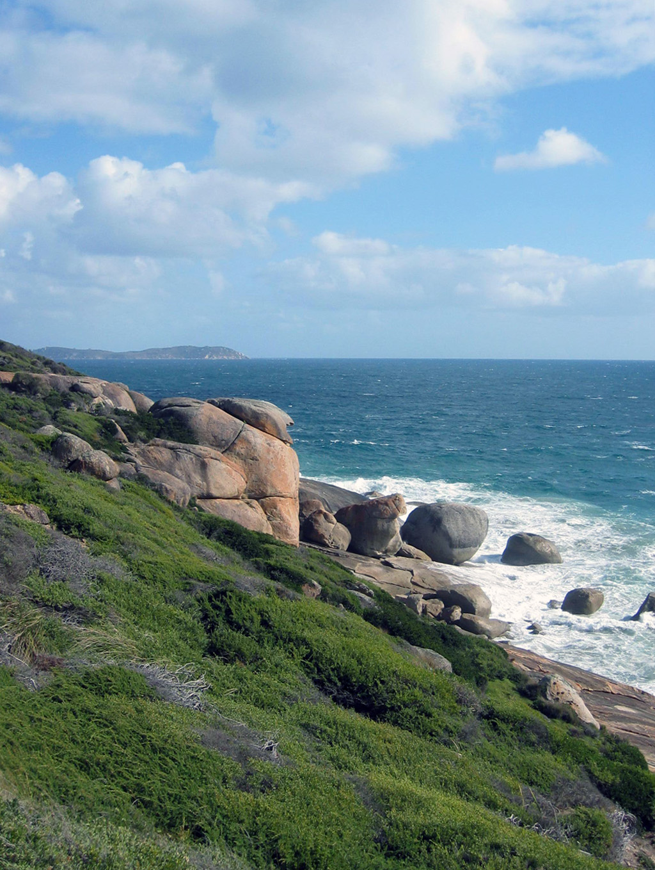
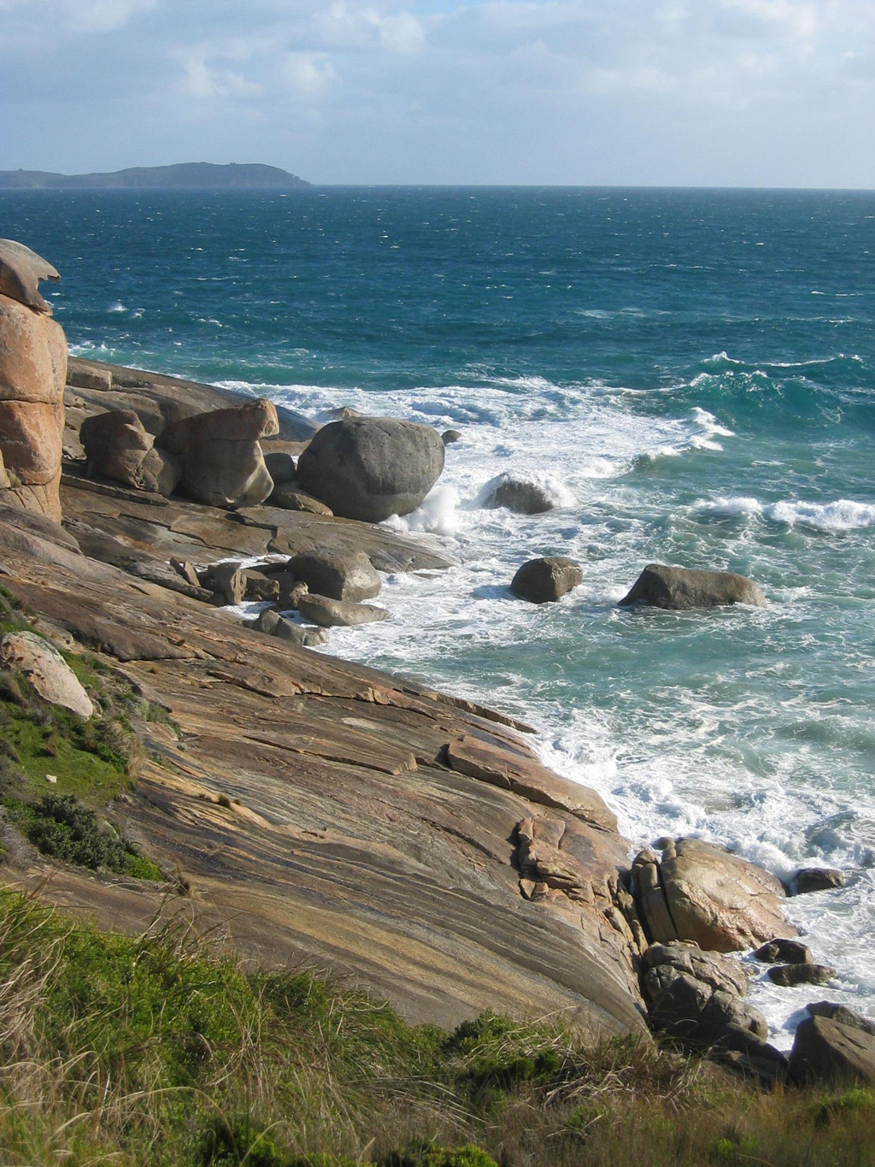
Granite-dominated west coast of Wilsons Promontory

Slide 10
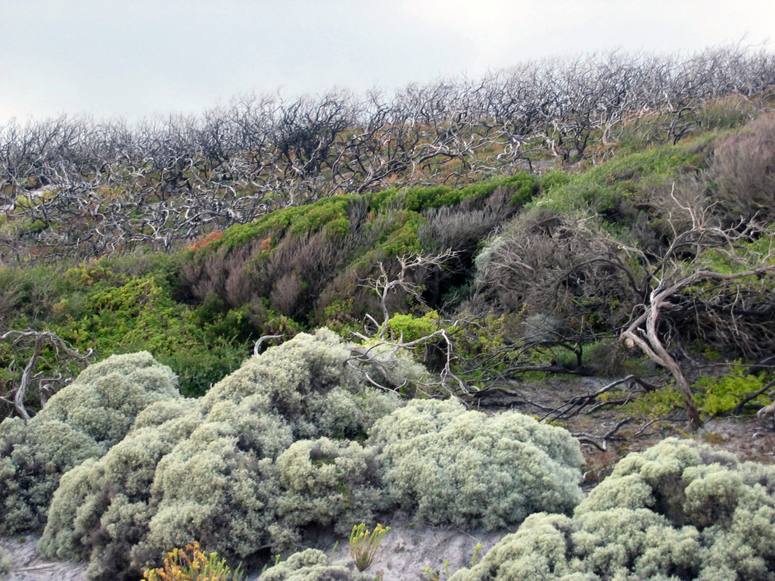
Wilsons Promontory supports a significant diversity of coastal vegetation

Slide 11
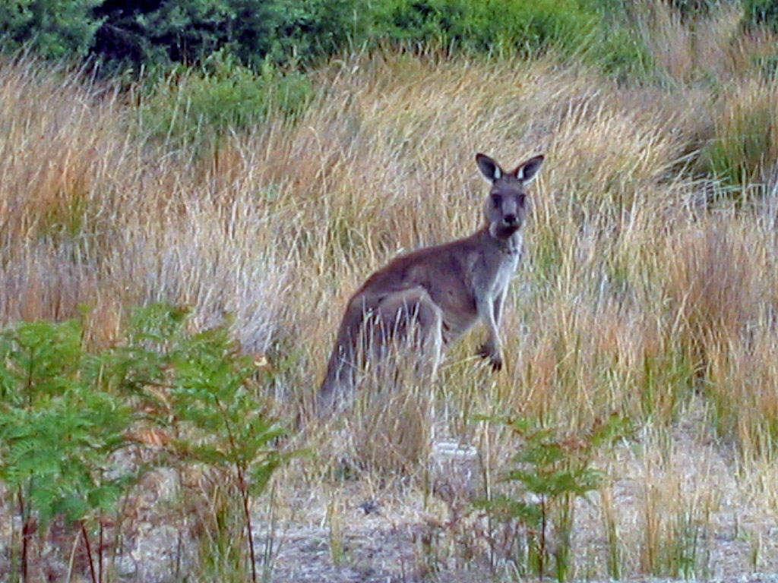
Wilsons Promontory supports a significant diversity of plants and animals
There are:
more than 700 native plant species
30 kinds of mammals
(marsupial mice, bats, kangaroos, koalas, seals, wallabies, wombats)
about 180 species of birds

Slide 12
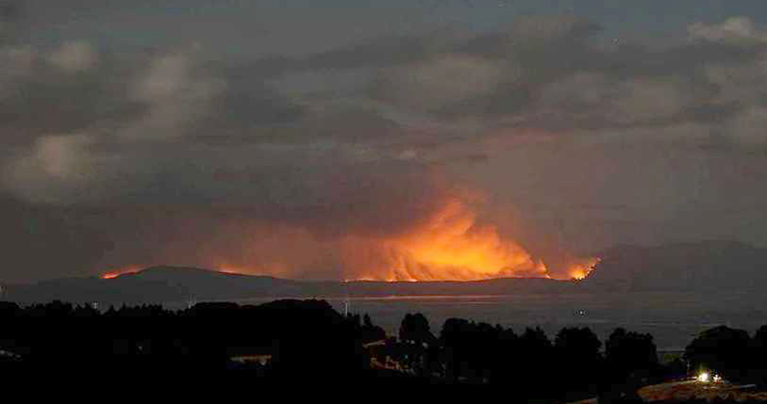
Wilsons Promontory National Park
Fire damage caused by recent bushfires, 10th February 2009 at 11pm

Slide 13
Site 1: Little Oberon Bay

Slide 14
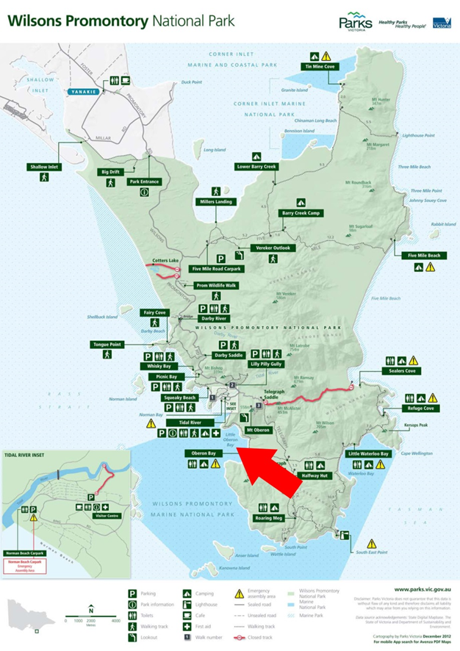
Location: Little Oberon Bay

Slide 15
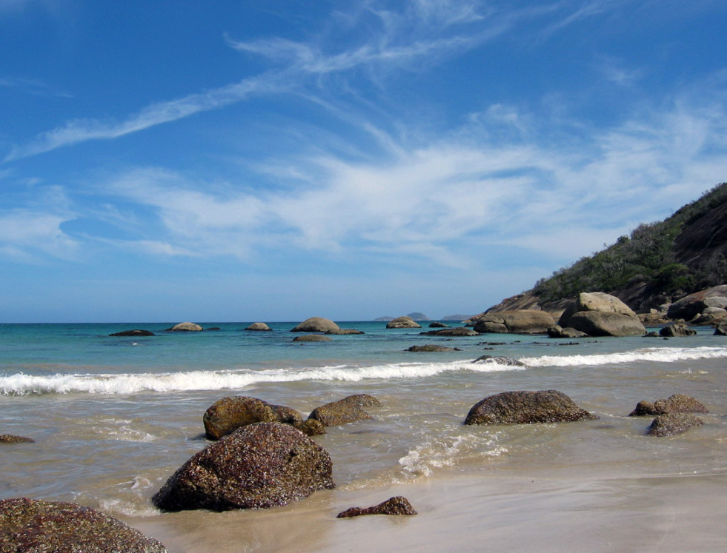
Little Oberon Bay beach and granite rocks

Slide 16
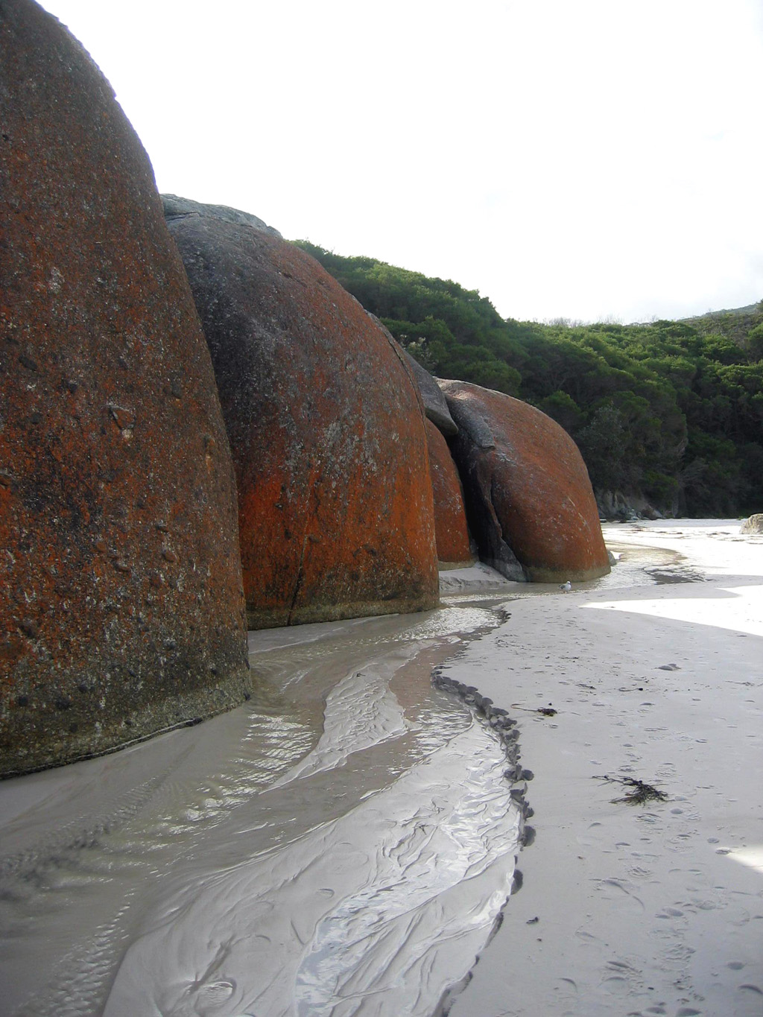
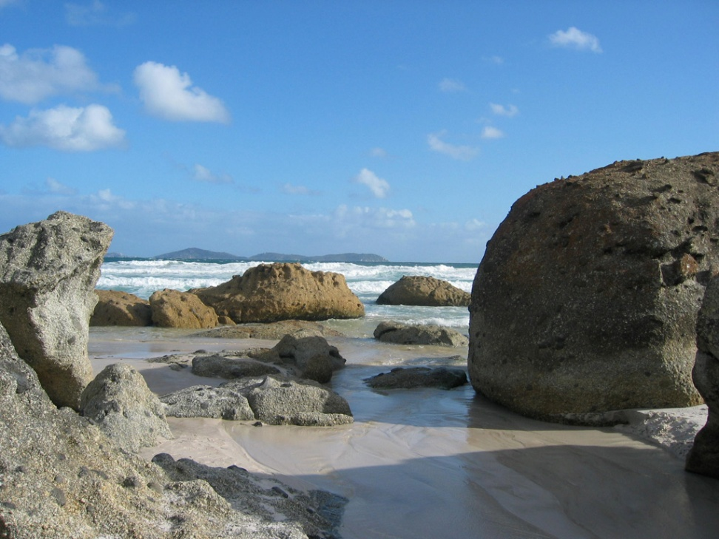
Granite rocks at Little Oberon Bay

Slide 17
Site 2: Norman Bay

Slide 18
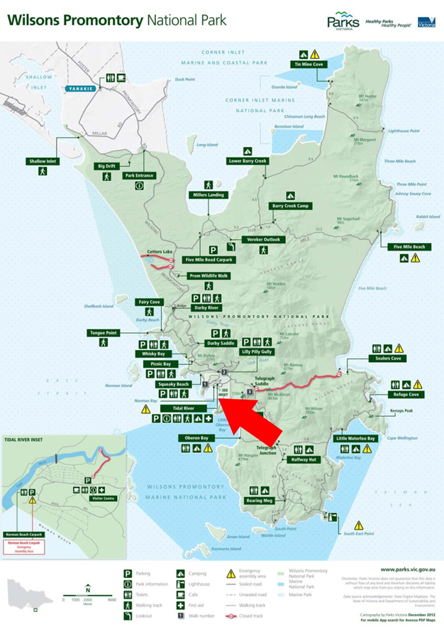
Location: Norman Bay

Slide 19
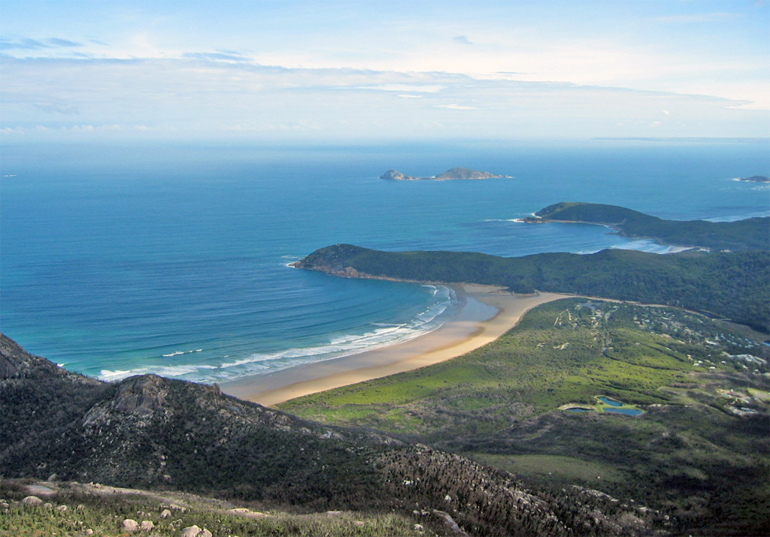
Norman Bay from Mount Oberon (558 metres)
Norman Bay and Tidal River estuary (left)
Leonard Bay and Leonard Point (middle distance)
Norman Island off Leonard Point

Slide 20
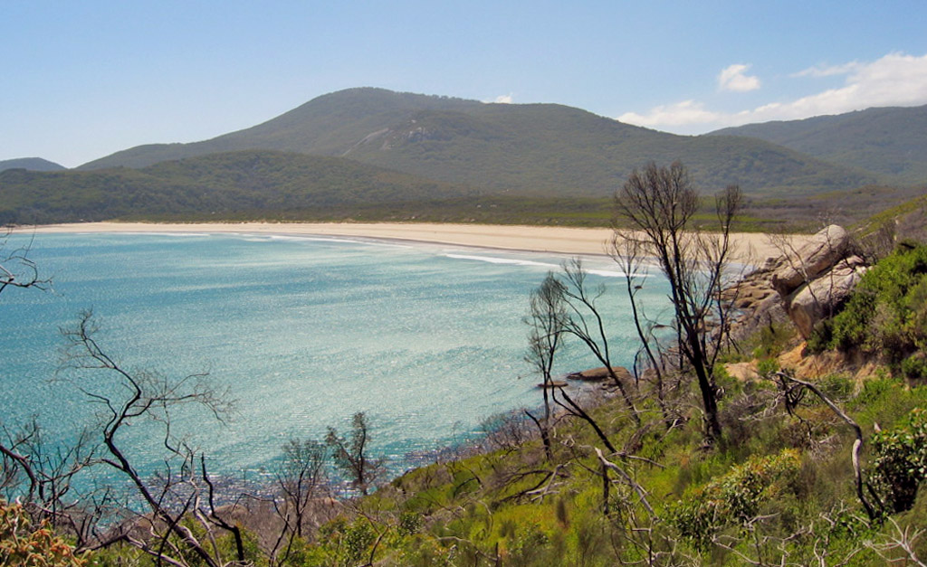
Norman Bay, looking north

Slide 21
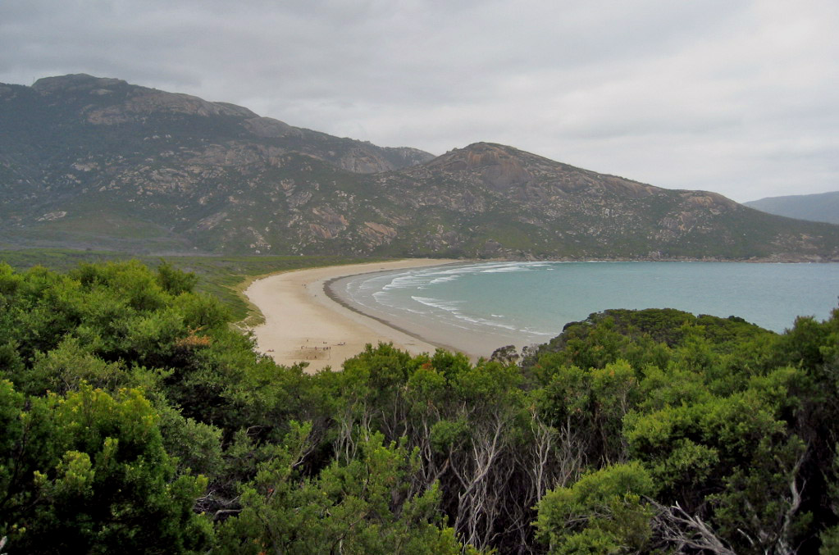
Norman Bay, looking south

Slide 22
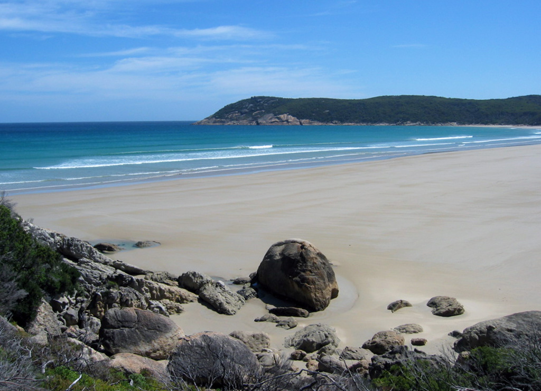
Norman Bay

Slide 23
Site 3: Tidal River

Slide 24
Location: Tidal River

Slide 25
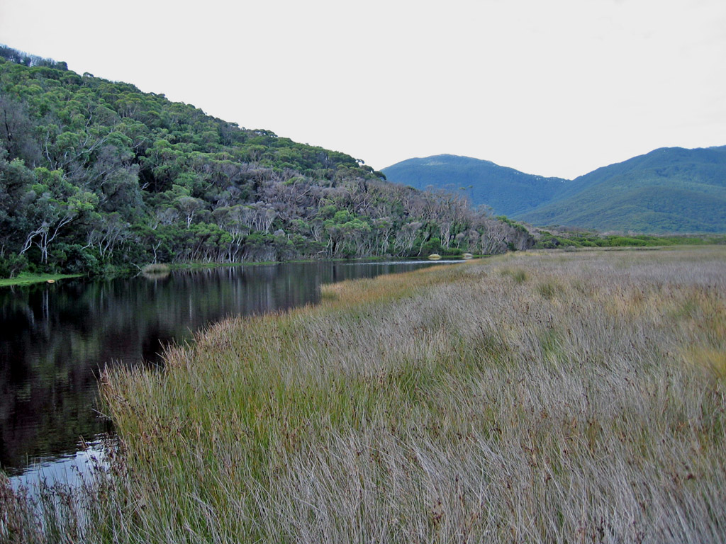
Tidal River, Loo-ern Track

Slide 26
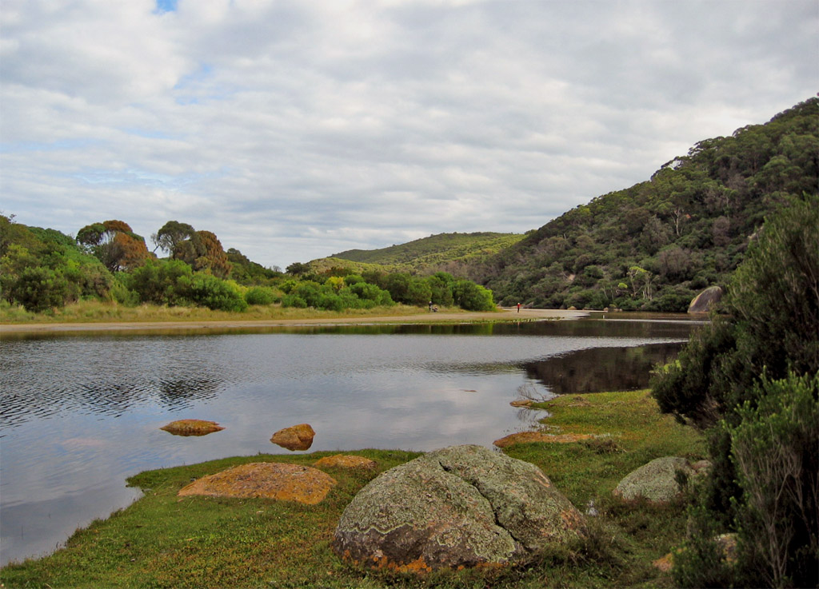
Tidal River, Loo-ern Track

Slide 27
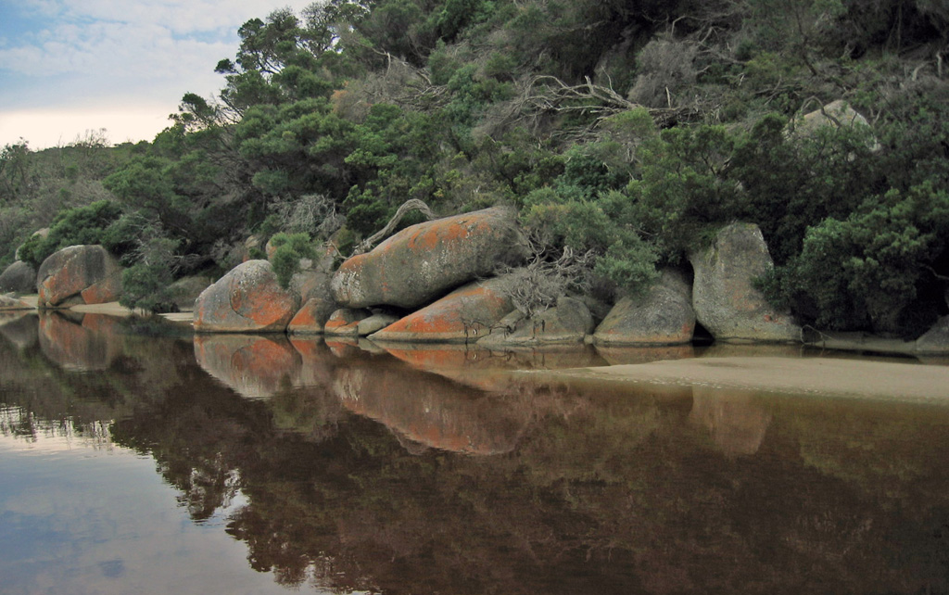
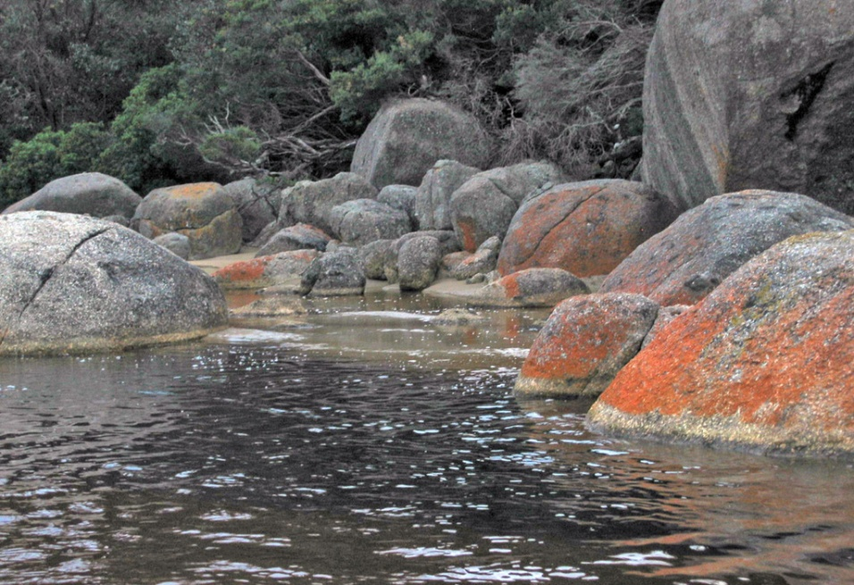
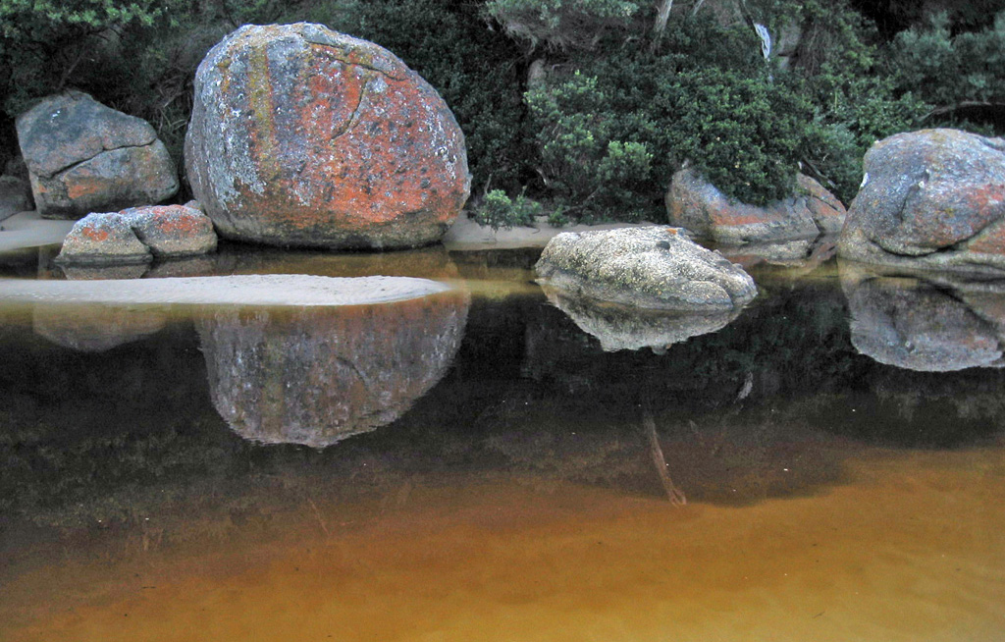
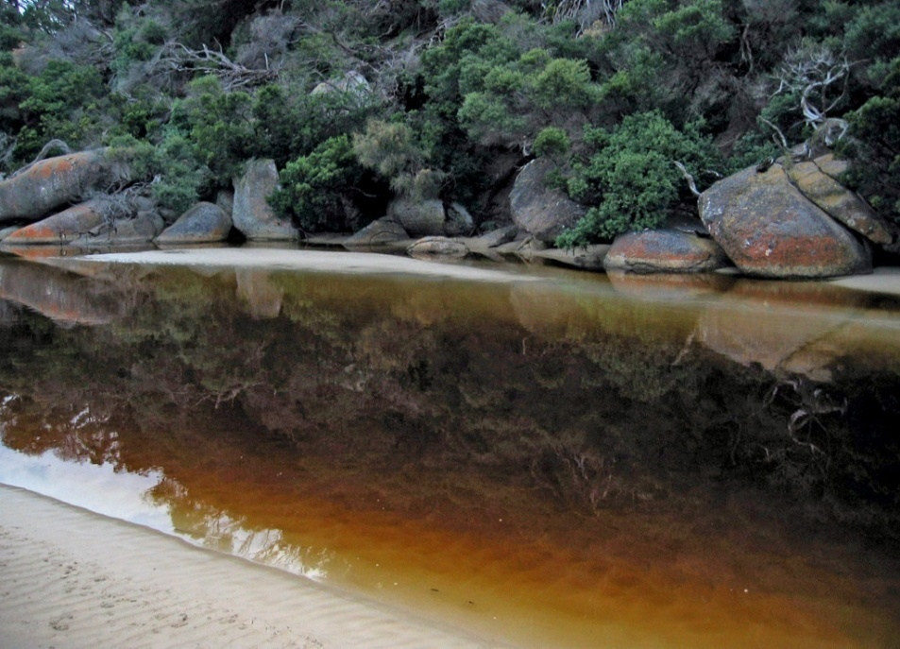
Tidal River, multi-coloured lichens on the granite boulders

Slide 28
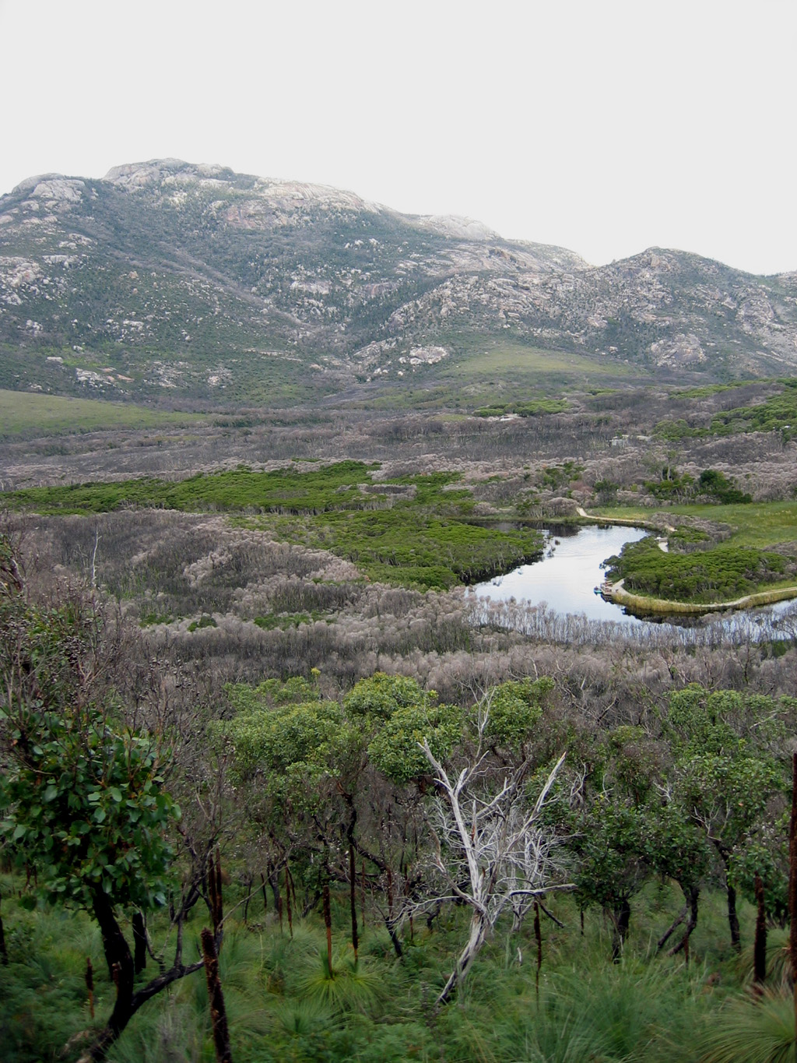
Tidal River, floodplain

Slide 29
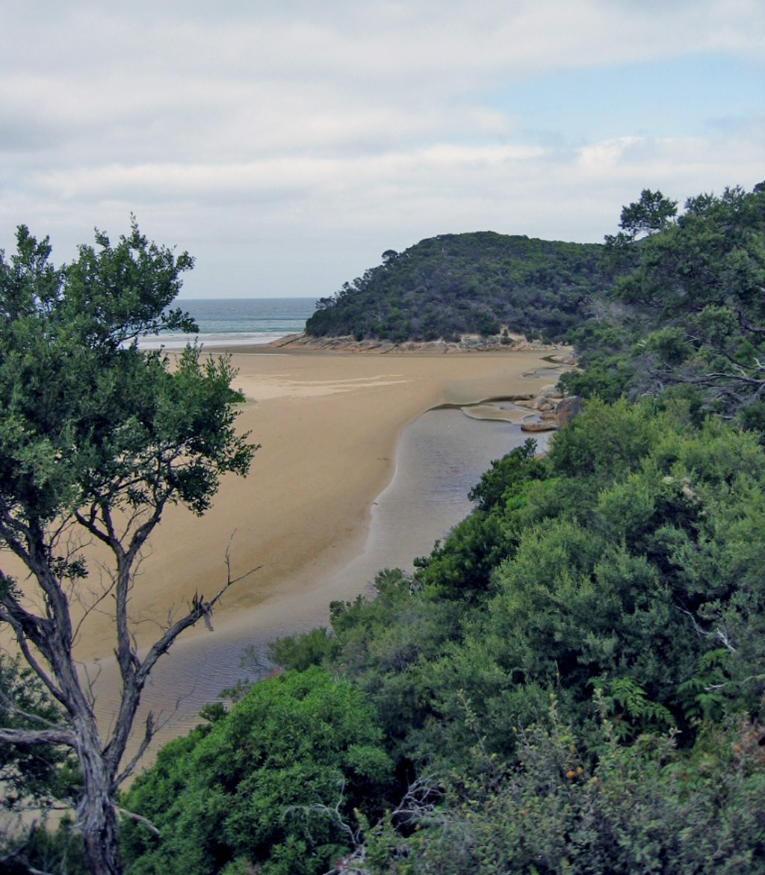
Tidal River where it enters Norman Bay

Slide 30
Site 4: Squeaky Beach

Slide 31
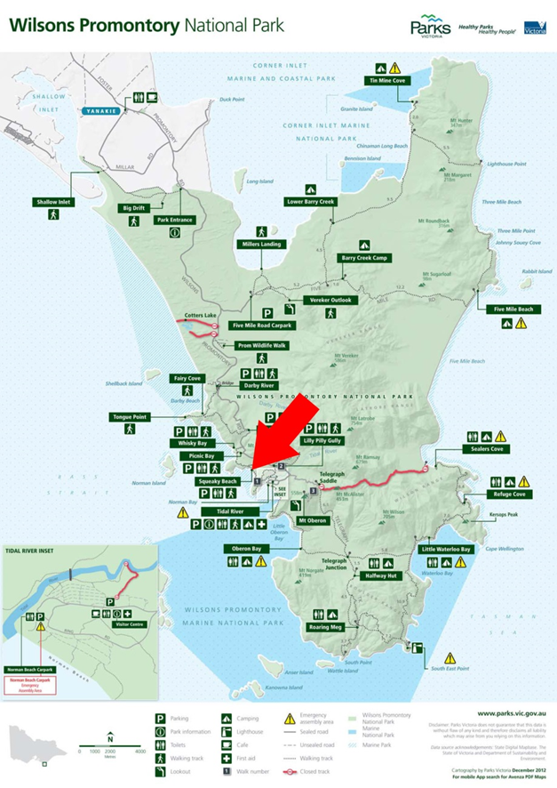
Location: Squeaky Beach

Slide 32
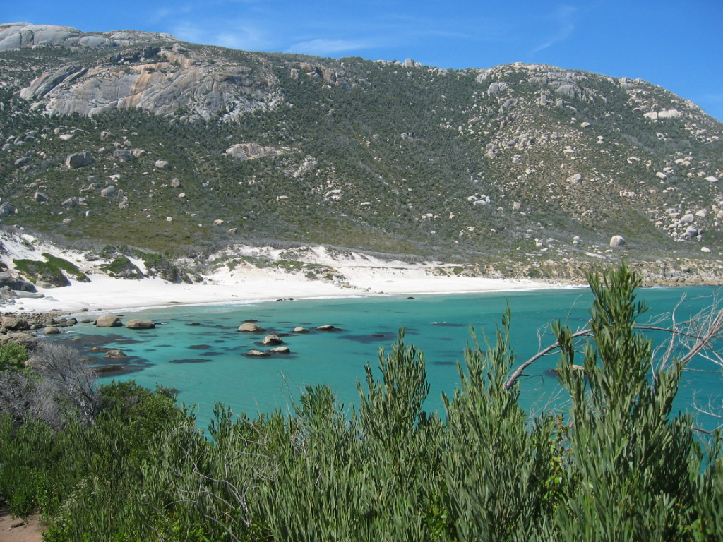
Squeaky Beach, looking south

Slide 33
Site 5: Leonard Point

Slide 34
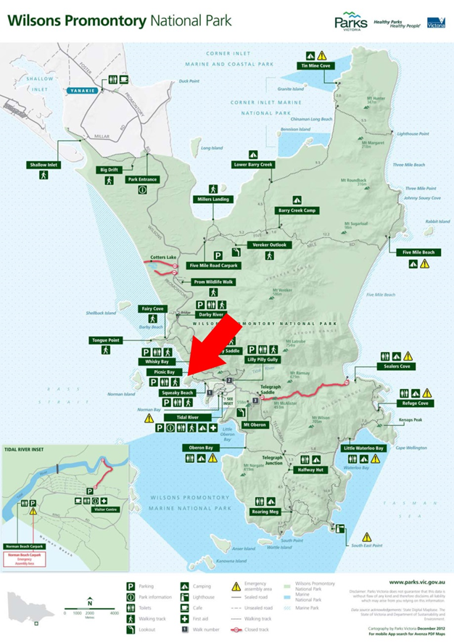
Location: Leonard Point

Slide 35
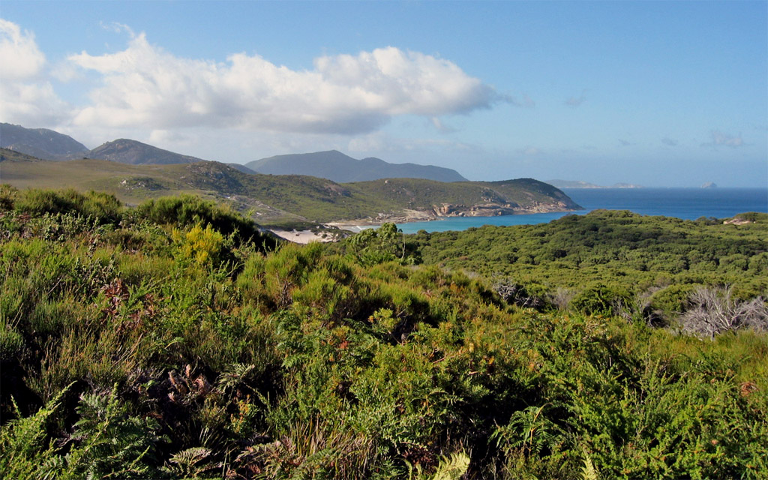
Leonard Point, looking south

Slide 36
Site 6: Vereker Outlook

Slide 37
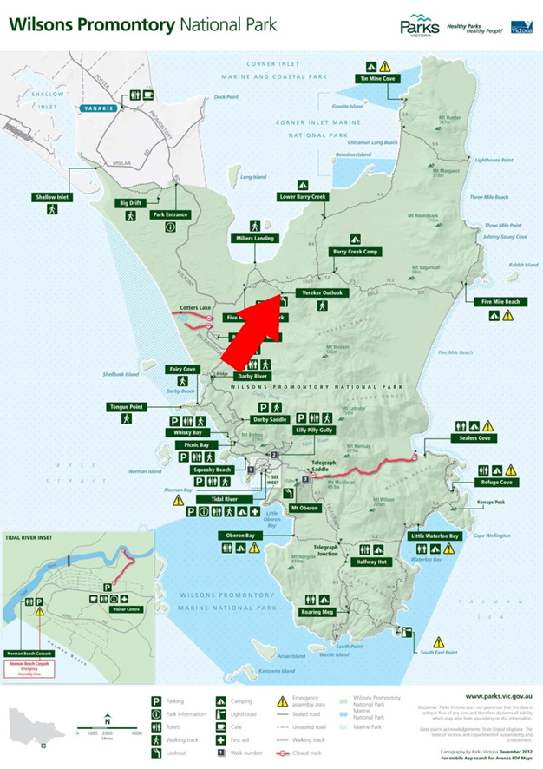
Location: Vereker Outlook (400 metres)

Slide 38
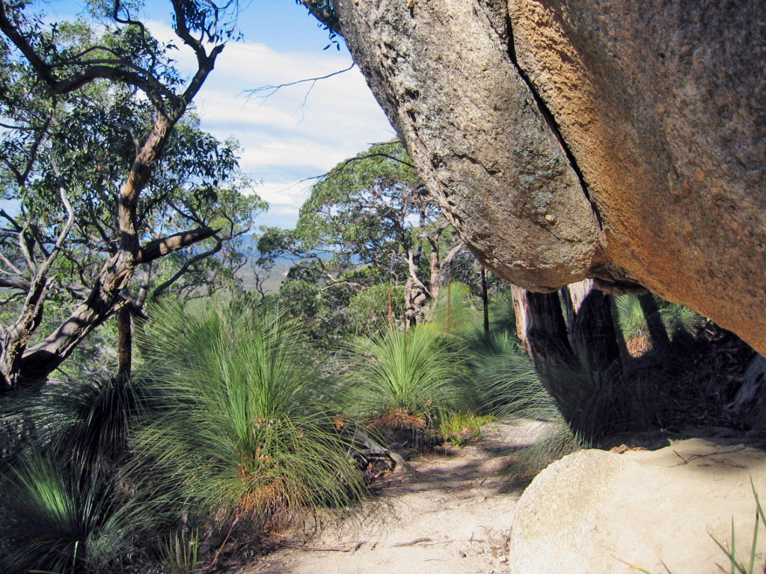
Track to Vereker Outlook (400 metres)

Slide 39
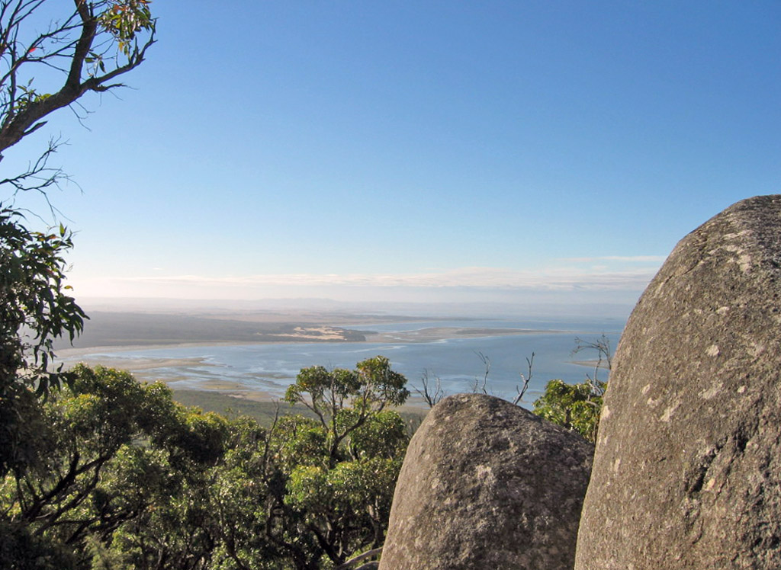
From Vereker Outlook (400 metres)

Slide 40
Further reading
Kettelsm, R. (2010). Southern star. Australian Geographic, 97, January–March, pp. 52–61.
Ingamells, P. (1999). Discovering the Prom. Victorian National Parks Association, Melbourne.
Meagher. D., & Kohout, M. (200). A field guide to Wilsons Promontory. Oxford University Press, Melbourne, 2002.
Neilson, D. (1996). Wilsons Promontory: Coastal wilderness. Melbourne: Snowgum Press, Melbourne.
Westcott, G. (1995). Wilsons Promontory: Marine and National Park, Victoria. Sydney: UNSW Press.
Websites:
Parks Victoria, http://www.parkweb.vic.gov.au
Tourism Australia, http://www.australia.com/itineraries/vic_wilsons_prom.aspx
Photograph source: All photographs provided by Roger Smith (author).

